Slide 1
Role of Science in Medicine
Role of Science in
Medicine

Slide 2
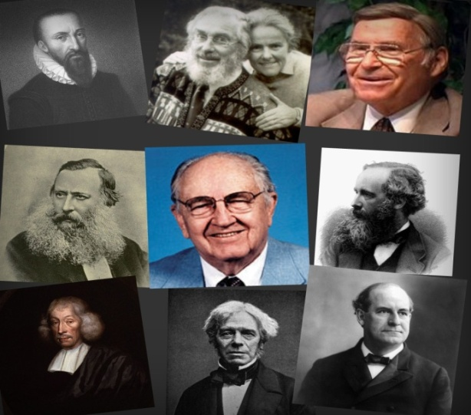
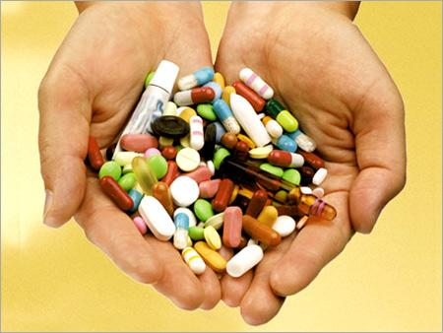
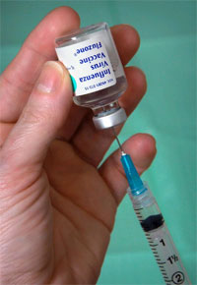
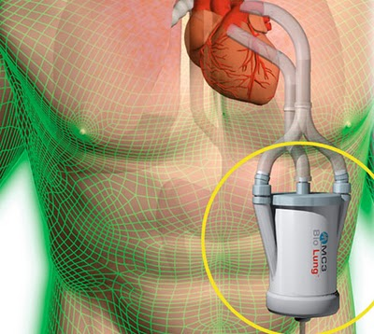
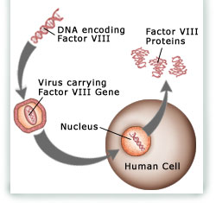
Index
What are
medicines?
Great
Scientists
History of
medicines
Modern
medicines
Artificial
organs
Gene
Therapy

Slide 3
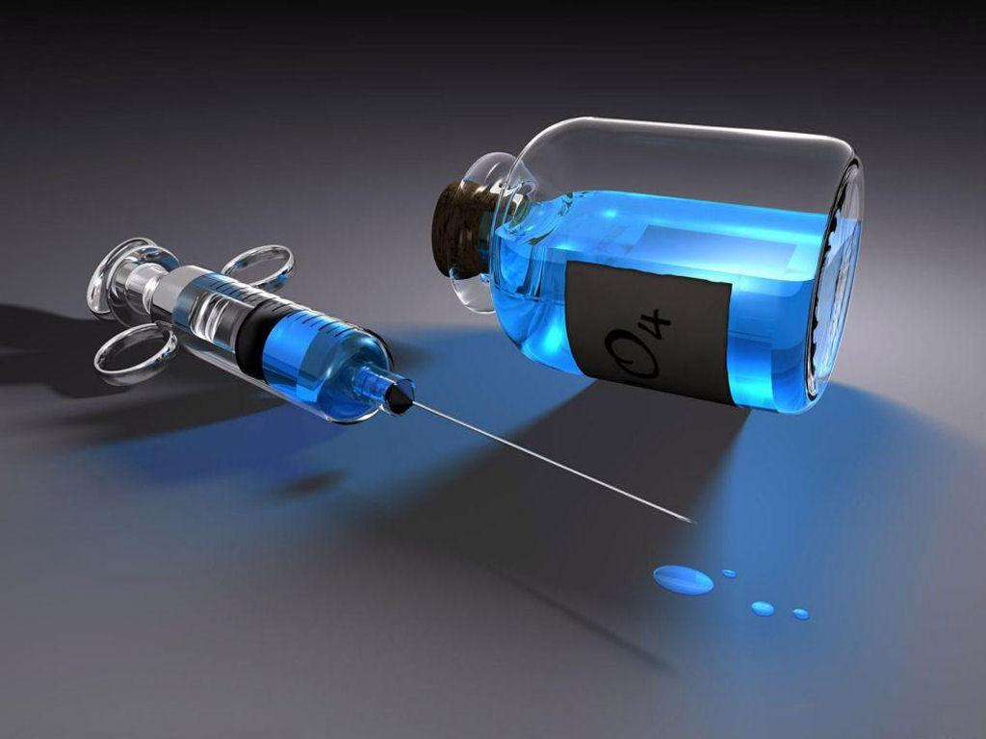
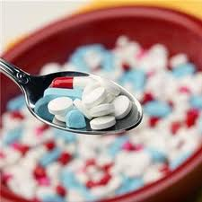
What is a medicine?
Medicine is the applied science or practice of the diagnosis, treatment, and prevention of disease. It encompasses a variety of health care practices evolved to maintain and restore health by the prevention and treatment of illness in human beings.

Slide 4
Index
What are
medicines?
Great
Scientists
History of
medicines
Modern
medicines
Artificial
organs
Gene
Therapy

Slide 5
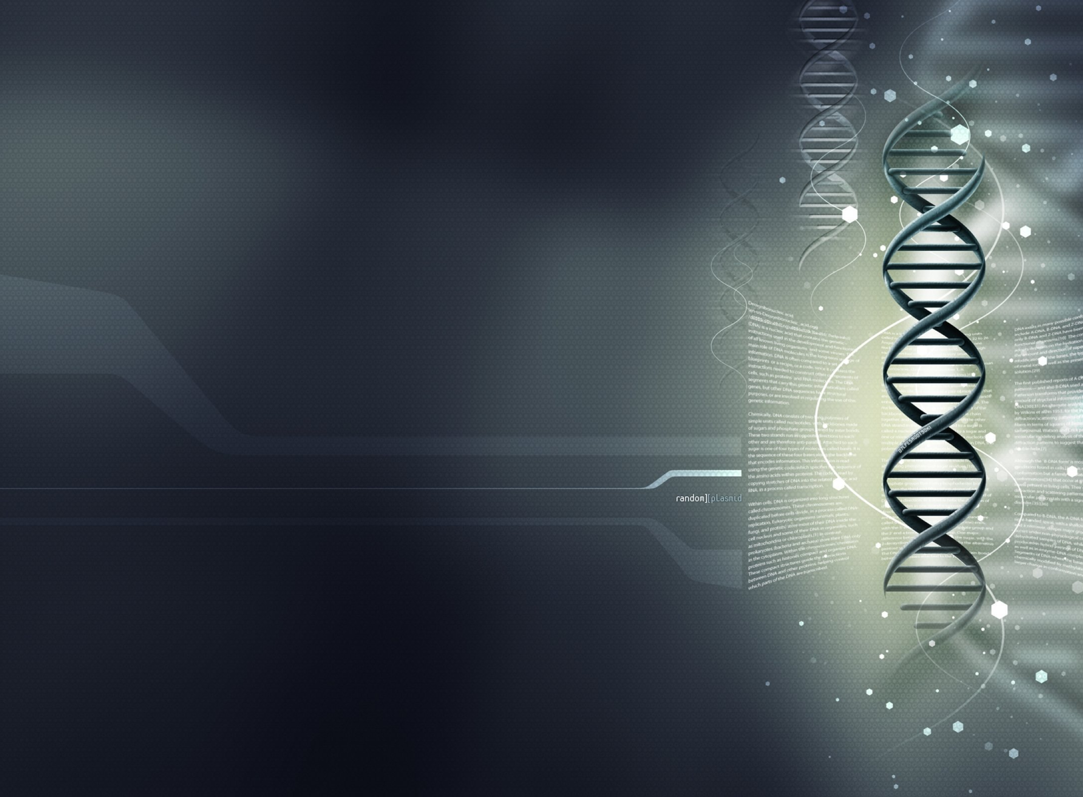
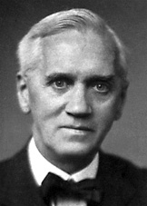
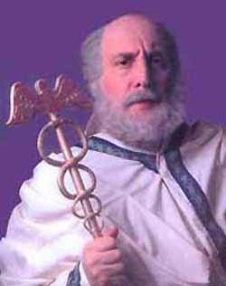
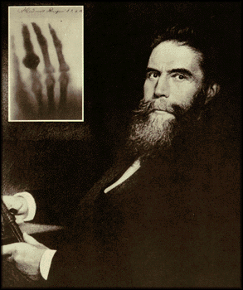
Contribution of great scientists
Alexander Fleming-Discoverer of penicillin
Hippocrates Categorized the illnesses as acute, chronic, endemic and epidemic
Wilhelm Conrad Röntgen-
Discovered x ray

Slide 6
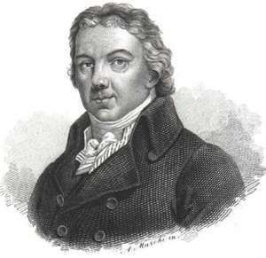
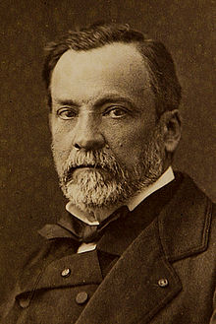
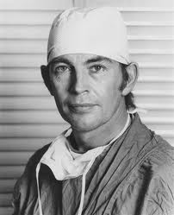
Edward Jenner-
discovered vaccination and considered as father of immunology
Louis Pasteur-
known for
pasteurization
Christian Barnard :
performed the first
successful
heart transplant

Slide 7
Index
What are
medicines?
Great
Scientists
History of
medicines
Modern
medicines
Artificial
organs
Gene
Therapy

Slide 8
History of Medical Science
History of Medical
Science

Slide 9
Ayurveda or ayurvedic medicine is a Hindu system of traditional medicine native to India and a form of alternative medicine. The earliest literature on Indian medical practice appeared during the Vedic period in India, i.e., in the mid-second millennium BCE.

Slide 10
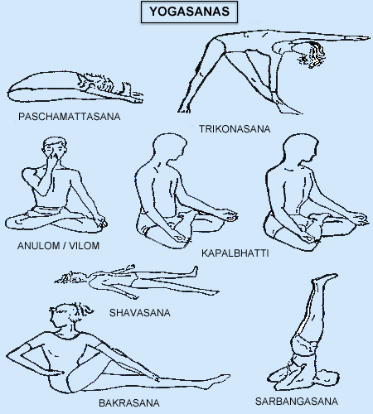
Yogasanas
Yogasanas

Slide 11
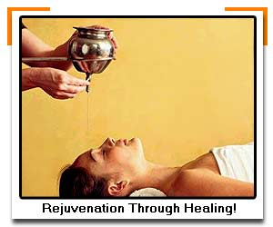
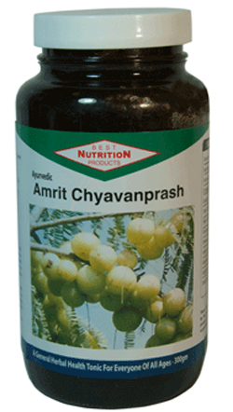
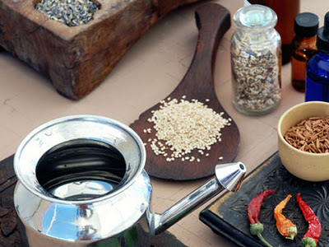
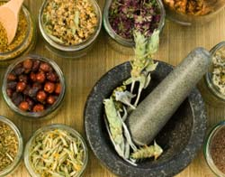
Old Medicines

Slide 12
Index
What are
medicines?
Great
Scientists
History of
medicines
Modern
medicines
Artificial
organs
Gene
Therapy

Slide 13
Introduction of
New medicines
Introduction of
New medicines

Slide 14
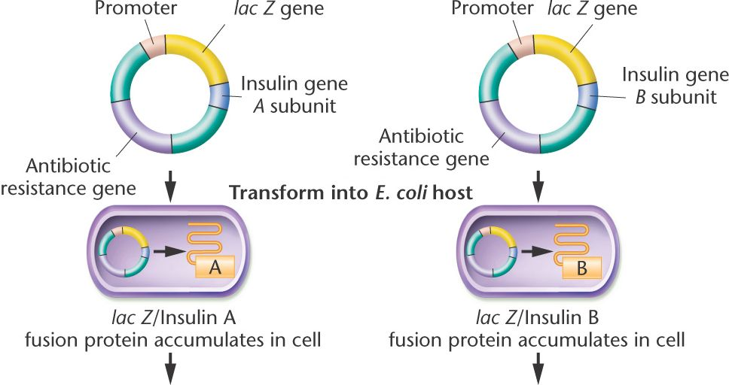
Recombinant Insulin
Recombinant Insulin

Slide 15
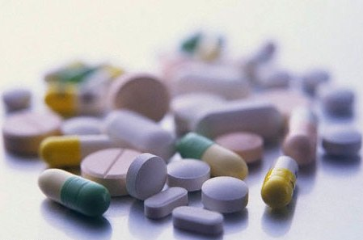
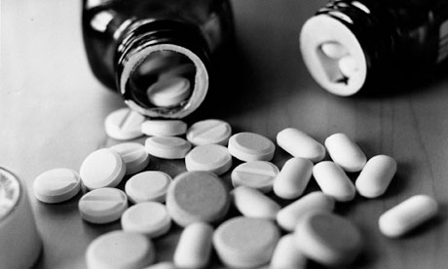
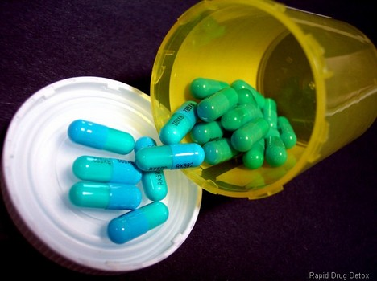
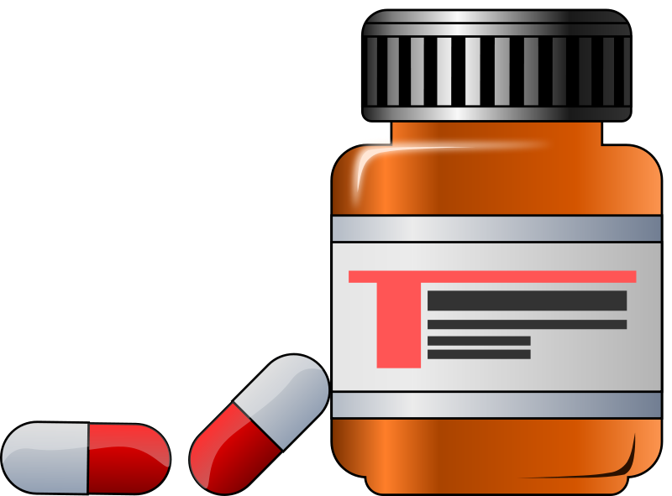
Modern
Medicines
Modern
Medicines

Slide 16
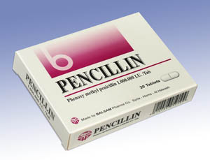
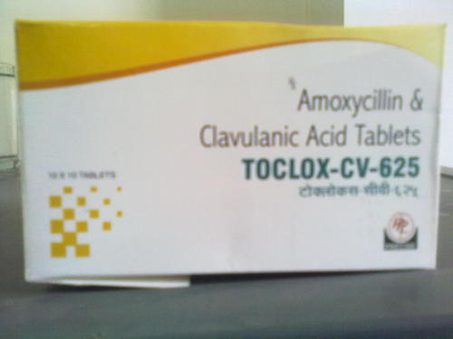
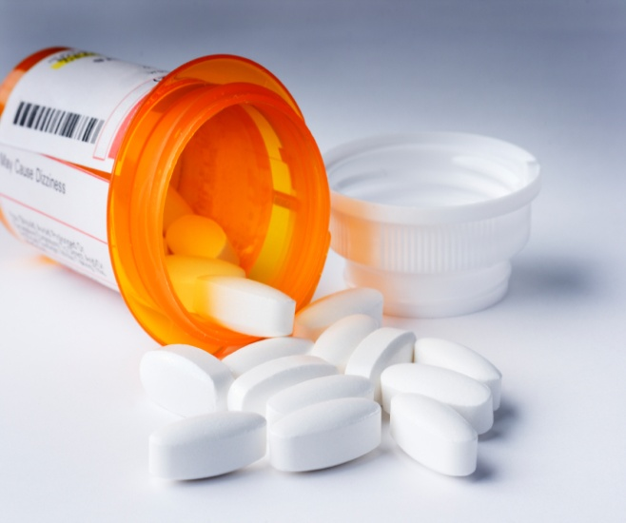
Drugs used in modern medicines
Penicillin VK-
antibiotic
Clavulanic- acid- antibiotic
Insulin: diabetes treatment

Slide 17
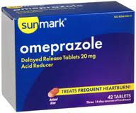
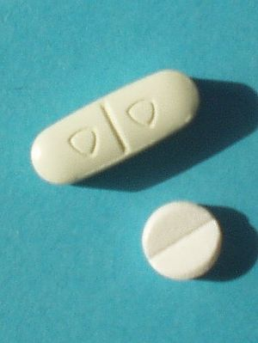
Omeprazole
anti-ulcer
Paroxetine
antidepressant
(SSRI)
Verapamil
calcium channel
blocker

Slide 18
Index
What are
medicines?
Great
Scientists
History of
medicines
Modern
medicines
Artificial
organs
Gene
Therapy

Slide 19
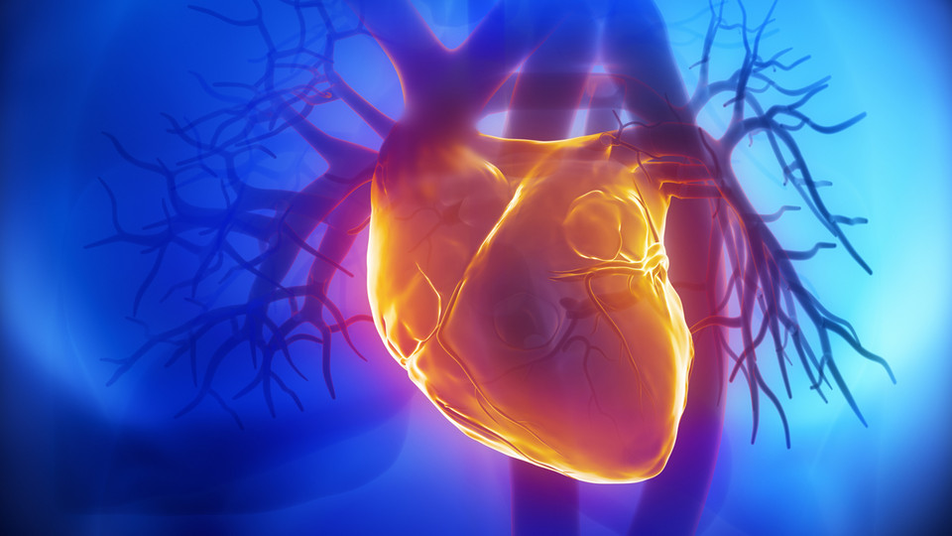
Artificial organs
Artificial organs
An artificial organ is a man-made device that is implanted or integrated into a human to replace a natural organ, for the purpose of restoring a specific function or a group of related functions so the patient may return to as normal a life as possible.

Slide 20
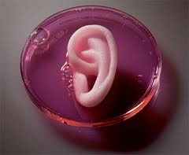
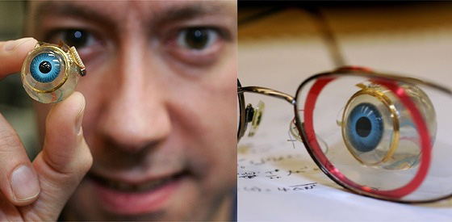
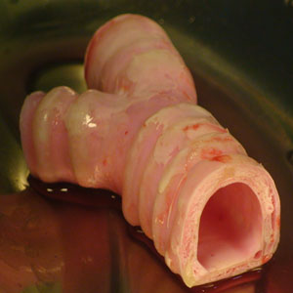
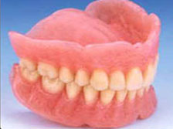
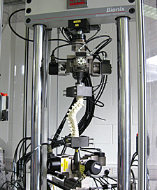
Widely used Artificial organs

Slide 21
Index
What are
medicines?
Great
Scientists
History of
medicines
Modern
medicines
Artificial
organs
Gene
Therapy

Slide 22
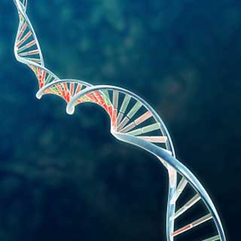
Gene therapy
Gene therapy
Gene therapy is the use of DNA as a pharmaceutical agent to treat disease. It derives its name from the idea that DNA can be used to supplement or alter genes within an individual's cells as a therapy to treat disease.

Slide 23
Made by:
Arpit Chawla
Naman Jindal
Deepanshu Galyan
Jatin Sethi

