Slide 1
ADARSH PUBLIC SCHOOL
Welcome to the Class-IX
Orientation Programme
Friday, April 12th 2013
Orientation Programme 2013

Slide 2
ADARSH PUBLIC SCHOOL
RULES & REGULATIONS
Regularity of attendance – 75%.
Punctuality – 7:45 am.
Half day leave prohibited especially
during Unit Tests.
No motorized vehicles, prefer bicycles.
Electronic gadgets not permitted.
Morning assembly – 2 times a week.
Orientation Programme 2013

Slide 3
ADARSH PUBLIC SCHOOL
RULES & REGULATIONS
Judicious use of school diary.
Prior permission for long leave from school.
No lavish celebration of birthday.
No late lunch boxes allowed.
Neat & tidy hair, nails & uniform.
Orientation Programme 2013

Slide 4
ADARSH PUBLIC SCHOOL
CCE for Class-IX
Orientation Programme 2013

Slide 5
ADARSH PUBLIC SCHOOL
CONTINUOUS AND COMPREHENSIVE EVALUATION (CCE)
Continuous : Continual and Regular Evaluation.
Comprehensive : An all round development of child’s personality.
Orientation Programme 2013

Slide 6
ADARSH PUBLIC SCHOOL
AIM OF CCE
To assess a child in areas like
Knowledge
Understanding
Applying
Analyzing
Evaluating
Creating
Orientation Programme 2013

Slide 7
ADARSH PUBLIC SCHOOL
Creating
Orientation Programme 2013

Slide 8
ADARSH PUBLIC SCHOOL
Comprehensive
Scholastic
Co - Scholastic
Orientation Programme 2013

Slide 9
ADARSH PUBLIC SCHOOL
Scholastic
It refers to those aspects which are related to intellect or the brain
Scholastic
Intellect
Brain
Orientation Programme 2013

Slide 10
ADARSH PUBLIC SCHOOL
Co-Scholastic
It refers to those aspects which are related to hand and heart
Hand
Co-Scholastic
Heart
Orientation Programme 2013

Slide 11
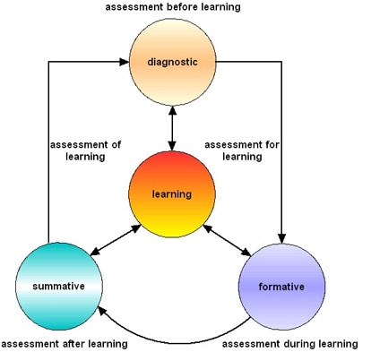
ADARSH PUBLIC SCHOOL
Scholastic
Part I
Orientation Programme 2013

Slide 12
ADARSH PUBLIC SCHOOL
Formative Assessment
Conversation Skills
Projects
Assignments
Quizzes
Oral Questions
Research Work (group)
Scholastic
Assessment
Summative Assessment
MCQ’s
Short Answer
Long Answer
Written -Term End Exam
Orientation Programme 2013

Slide 13
ADARSH PUBLIC SCHOOL
Formative and
Summative Assessment
Term I
(April – September)
Term II
(October – March)
Orientation Programme 2013

Slide 14
ADARSH PUBLIC SCHOOL
Procedure for session 2013-14
Summative Assessments
Term I(September)
Term II(March)
Total Marks - 90 each
Weightage
SA I - 30%
SA II - 30%
Note * Separate syllabus for Term I and Term II
Orientation Programme 2013

Slide 15
ADARSH PUBLIC SCHOOL
Formative Assessments (10% each)
FA I - April – May
FA II - July - August
FA III - October- November
FA IV - December – February
FA IV (Problem Solving Assessment - PSA) - February
Note - to be conducted by CBSE
Division of Marks
Unit Test C.W./H.W. Activities | 25 10 15
Total Marks 50

Slide 16
ADARSH PUBLIC SCHOOL
Scholastic Areas 9 point grading system
Part I A
MARKS RANGE | GRADE
91-100 | A1
81-90 | A2
71-80 | B1
61-70 | B2
51-60 | C1
41-50 | C2
33-40 | D
21-32 | E1
20 and below | E2
Orientation Programme 2013

Slide 17
ADARSH PUBLIC SCHOOL
Co-Scholastic Areas
5 Point Grading System
Grade Point | GRADE
5 | A
4 | B
3 | C
2 | D
1 | E
Orientation Programme 2013

Slide 18
ADARSH PUBLIC SCHOOL
CO-SCHOLASTIC AREAS
Part 2(A) :- Life Skills
A) Thinking Skills
Creative Thinking
Critical Thinking
Problem Solving
Decision Making
B) Social Skills
Communication Skills
Interpersonal Skills
C) Emotional Skills
Dealing with Emotions
Dealing with Stress
Self Awareness
Orientation Programme 2013

Slide 19
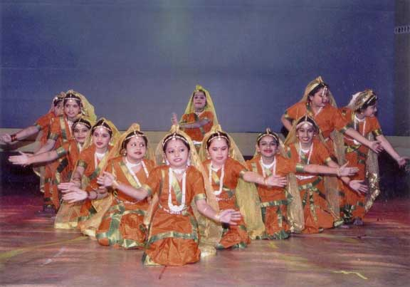
ADARSH PUBLIC SCHOOL
CO-SCHOLASTIC AREAS
Computer Operation
Cookery Skills
Part 2(B) :- Work Education
Dance
Drama
Art Education
Music
Part 2(C) :- Visual And Performing Arts
Orientation Programme 2013

Slide 20
ADARSH PUBLIC SCHOOL
CO-SCHOLASTIC AREAS
Teachers
School Mates
School Programmes & Environment
Value Systems
Part 2(D) :- Attitudes And Values Towards
Orientation Programme 2013

Slide 21
ADARSH PUBLIC SCHOOL
Part 3(A) :- CO-SCHOLASTIC ACTIVITIES (Any Two)
Literary and Creative Skills
Scientific Skills
Information and Technology
Organization and Leadership Skills
Part 3(B) :- HEALTH AND PHYSICAL ACITIVITIES
Sports
Yoga
Orientation Programme 2013

Slide 22
ADARSH PUBLIC SCHOOL
CO-SCHOLASTIC AREAS AND ACTIVITIES
Upgradation criterion : 53 - 65 (Two Subjects)
40 - 52 (One Subject)
** Upgraded Grade
CGPA (Cumulative Grade Point Assessment)
EXAMPLE: A1 Grade in all subjects = CGPA 10
Evidence of assessment (scholastic and co-scholastic)
Orientation Programme 2013

Slide 23
ADARSH PUBLIC SCHOOL
Latest Addition by CBSE
Problem Solving Assessment (PSA) – FA 4
One language (Hindi / English), Mathematics, Science, Social Science
90 Marks Paper.
Tests qualitative, quantitative and logical reasoning.
Listening and Speaking skills in English
10 Marks ( 5 Mark Listening and 5 Mark Speaking )
25% Marks compulsory in summative assessment
(Term I & II).
Orientation Programme 2013

Slide 24
ADARSH PUBLIC SCHOOL
Orientation Programme 2013

